Slide 1
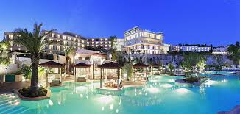
ATLIQ GRANDS
Presented by Janaki Patel

Slide 2
Problem Statement
AtliQ Grands owns multiple five-star hotels across India. They have been in the hospitality industry for the past 20 years. AtliQ Grands owns multiple five-star hotels located in major Indian cities, including Delhi, Mumbai, Hyderabad, and Bangalore. Their hotels cater to both luxury and business segments. The accommodations include a variety of room types, such as Standard, Elite, Premium, and Presidential suites.
Due to strategic moves from other competitors and ineffective decision-making in management, AtliQ Grands are losing its market share and revenue in the luxury/business hotels category.
As a strategic move, the managing director of AtliQ Grands wanted to incorporate “Business and Data Intelligence” to regain their market share and revenue. However, they do not have an in-house data analytics team to provide them with these insights.
As a data analyst, task is to utilize sample data and develop a dashboard and generate insights.

Slide 3
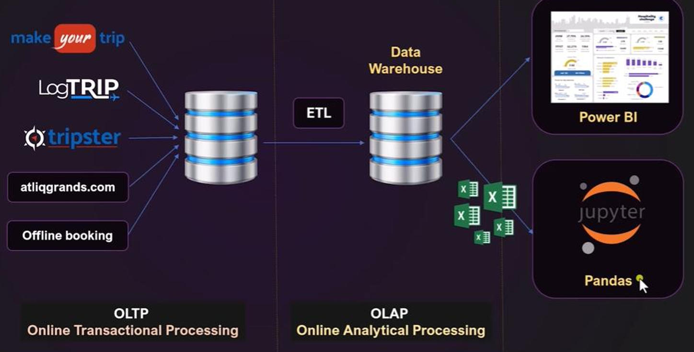
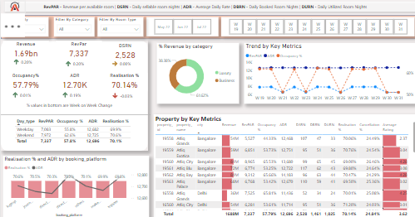

Slide 4
Key Metrices
ADR (Average Daily Rate): The average revenue earned per room sold in a given time period.
DBRN (Daily Booking Room Nights): The average number of rooms are booked for a day considering a time period
DSRN (Daily Sellable Room Nights): The average number of rooms available for sale per day over a specified time period.
DURN (Daily Utilized Room Nights): The average number of rooms successfully occupied by guests per day over a specified time period.
RevPAR (Revenue Per Available Room): The revenue generated per available room, regardless of whether it is occupied.
Realization %: The percentage of successful check-outs compared to the total number of bookings made.

Slide 5
Data Analysis using Pandas

Slide 6
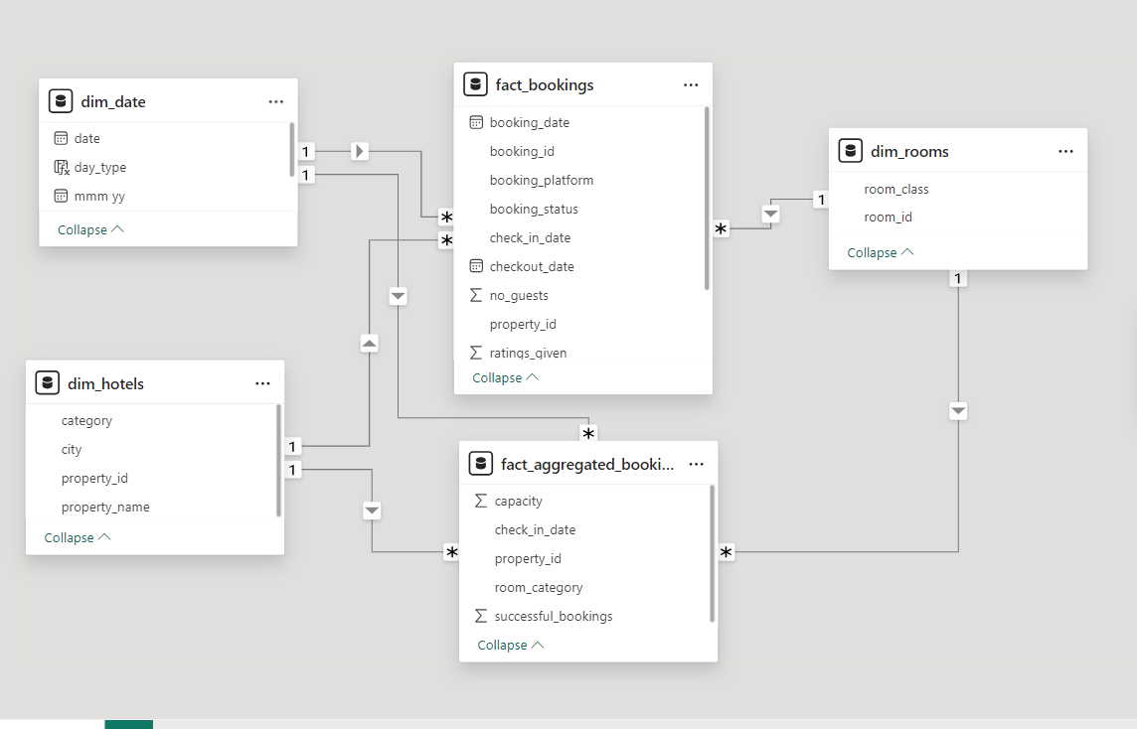
Data Modelling

Slide 7
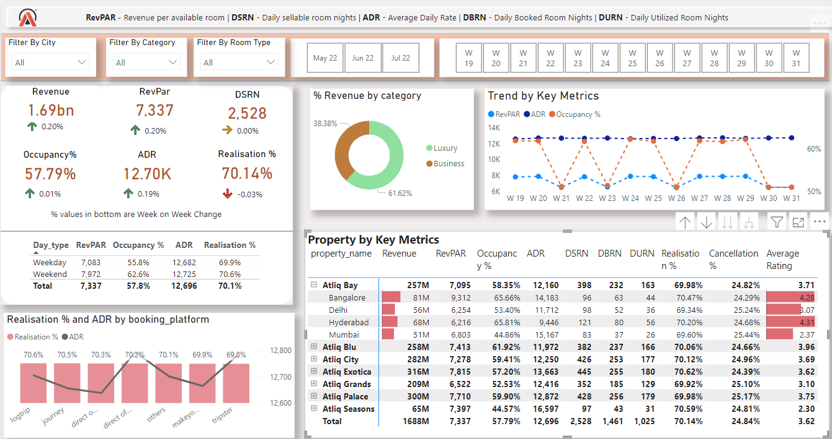

Slide 8
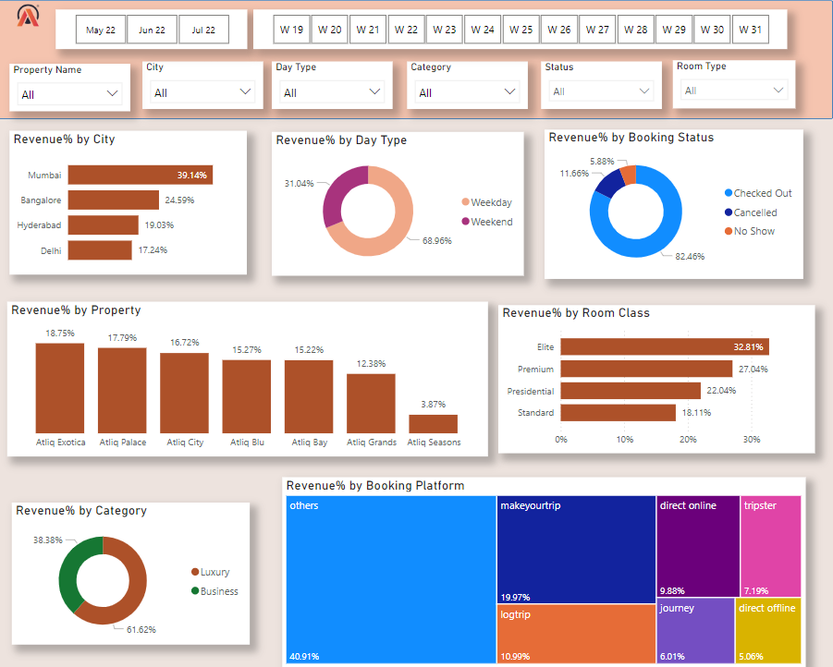

Slide 9
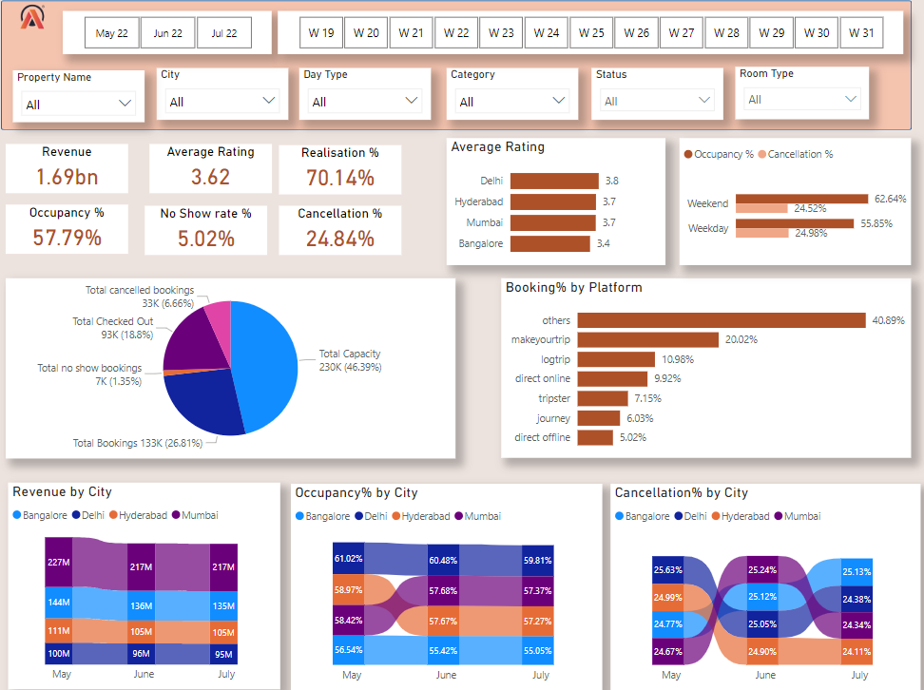

Slide 10
Insights
Mumbai Generated Highest (660M) revenue with contribution of 39.13% and Delhi generated Lowest Revenue (290.92) with contribution of 17.24%.
Occupancy % : Delhi is leading in 1st position with 60.44% and Bangalore is in last position with 55.68%.
Cancellation %: Delhi is having more cancellation% of 25.63% compared to other cities.
May 2022 recorded the highest revenue of 582M, followed by June 2022 with 554M and July 2022 with 551M.
Elite rooms dominate with a significant RC % of 32.81%.
Luxury category outperforms, contributing of 61.62% of revenue compared to the Business category of 38.38%.
"Make Your Trip" accounts for approximately 19-20% of revenue. Approximately 40% of revenue originates from unidentified sources, warranting focused identification efforts for enhanced marketing strategies.
AtliQ Exotica leads with an RC % of 18.75%, followed closely by AtliQ Palace at 17.79%. AtliQ Seasons lags significantly with an RC % of 3.87%, indicating room for improvement
Insite of DSRN, Lowest(435) for Delhi.
RevPAR is Highest for Mumbai And Lowest for Hyderabad.

